Slide 1

MGMT 585 - IT Project Management
Alternative Group Project – Managing and Delivering an Analytics Project
Dataset - Airbnb
Team – Time Value
Aravind Teja Chikoti, Avishek Dasgupta, Vishnu Vardhan Ponduri, Sohan Kumar Sahoo, Mourya Gupta Vakacharla

Slide 2
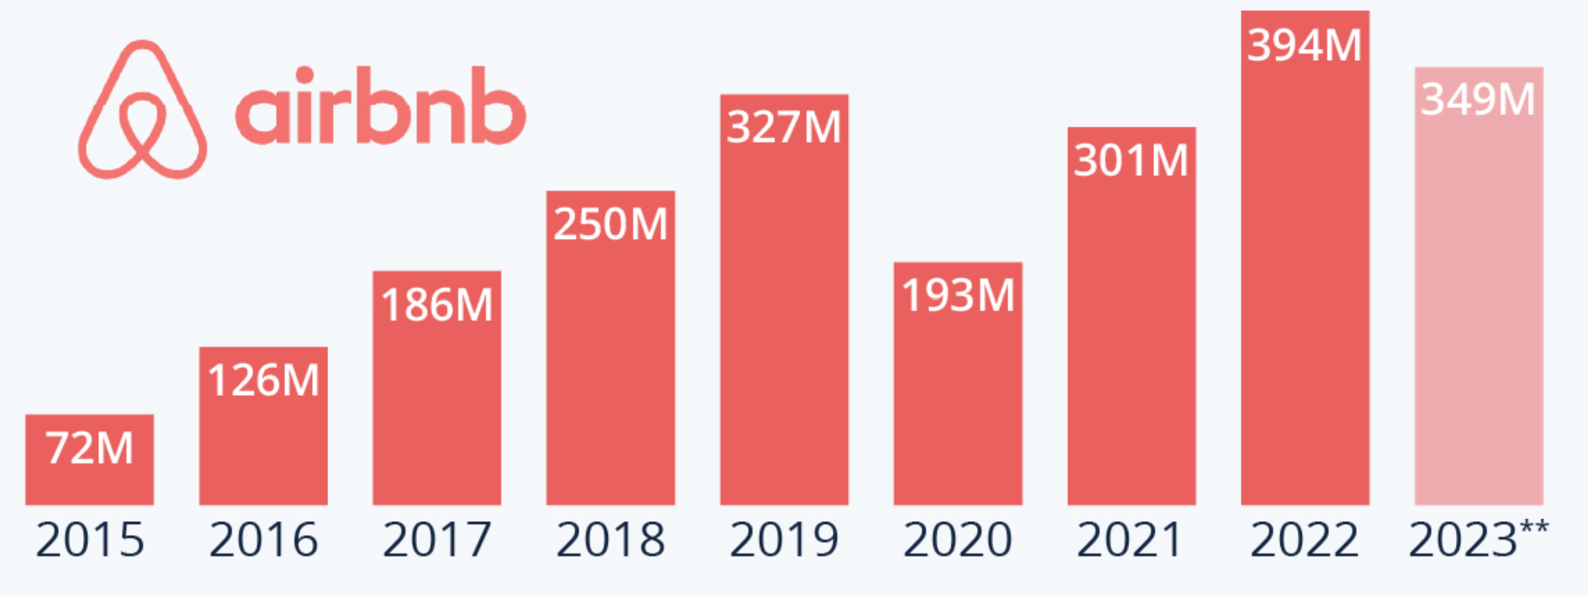


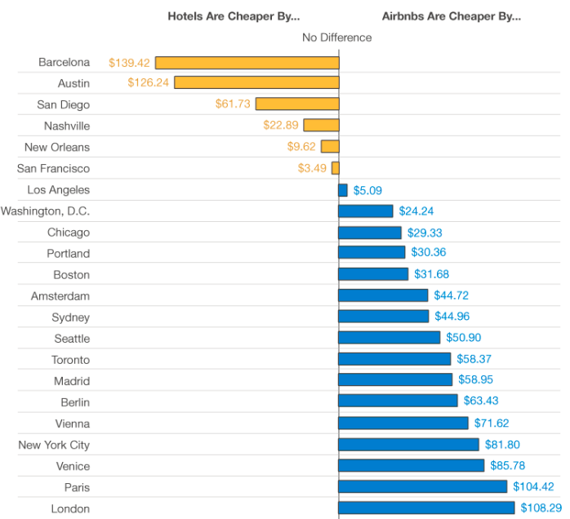




Introduction – The Airbnb Story
Why is Airbnb so successful?
First to Market for transaction based temporary accommodation
High Incentive for hosts to lend part or entire house temporarily
Airbnb Market Growth over Years
Extremely easy to use with customized search options
Host Property Damage Protection provided by AirBnb
Hosts have to list properties only once vs. multiple times in other competitors
Instant Brand Recognition and trust
Comparative Cost of Airbnb over others

Slide 3




Part I: Problem Description
Business Problem 1
Objective: To evaluate the performance of the superhost status criteria by Airbnb.
Why is this significant?
- To address recent concerns and negative sentiments expressed by both superhosts and customers regarding the superhost status criteria on Airbnb.
- To gather insights from the evaluation and make any necessary adjustments to enhance the program, ensuring it aligns with the expectations of hosts and guests for a more positive hosting experience.
Business Problem 2
Objective: To do a tract level analysis and finding the factors affecting the average bookings at tract level.
Why is this significant?
Conducting a tract level analysis will help to understand factors influencing average bookings, which will address concerns and optimize the Airbnb platform for both hosts and guests.

Slide 4
Part II: Project Management Principles
Initiation
and Planning
Project Closure
Project Management Principles
Resource
Allocation
and Cost
Estimation
Agile
Flexibility
Execution
and
Monitoring
Risk
Management
Communication
and Stakeholder
Engagement

Slide 5

Part II (a): MS Project Management Plan
Software: MS Project
Project Name: Airbnb Analytics Project
Project Start Date: 02/19/2024

Slide 6
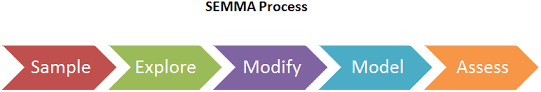
Part II (a): WBS (Work Breakdown Structure)
Task Name
1. Start Project
2. Initiating Tasks
2.1 Initial Meeting
2.2 Draft Project Requirements
2.3 Review With Stakeholders
2.4 Develop Project Charter
2.5 Charter Signed
3. Planning Tasks
3.1 Develop WBS
3.2 Estimate Task Duration
3.3 Assign Resources
3.4 Determine Task Relationships
3.5 Enter Cost Information
3.6 Review Gantt and Pert Chart Information
4. Sample Tasks
4.1 Collect Datasets
4.2 Data Segmentation
5. Explore Tasks
5.1 Data Cleaning
5.2 Initial Data Exploration
5.3 Demographic Analysis of Superhosts
Task Name
6. Modify Tasks
6.1 Feature Engineering
6.2 Sentiment Analysis Data Preparation
7. Model Tasks
7.1 Model Development
7.2 Model Comparison and Optimization
7.3 Churn and Superhost Status Analysis
8. Assess Tasks
8.1 Model Evaluation
8.2 Stakeholder Review
8.3 Model Refinement
9. Closure Tasks
9.1 Prepare Final Project Report
9.2 Present Final Project to Stakeholders
9.3 Prepare Lessons Learned
10. End Project

Slide 7
Part II (a): Tasks, Durations & Predecessors
Task Name | Duration | Predecessors
1. Start Project | 0 | -
2. Initiating Tasks | - | 1
2.1 Initial Meeting | 1 | 1
2.2 Draft Project Requirements | 2 | 3
2.3 Review With Stakeholders | 1 | 4
2.4 Develop Project Charter | 1 | 4
2.5 Charter Signed | 0 | 6
3. Planning Tasks | - | 7
3.1 Develop WBS | 2 | 7
3.2 Estimate Task Duration | 2 | 9
3.3 Assign Resources | 2 | 9
3.4 Determine Task Relationships | 1 | 9
3.5 Enter Cost Information | 1 | 9
3.6 Review Gantt and Pert Chart Information | 1 | 11,12,13
4. Sample Tasks | - | 14
4.1 Collect Datasets | 2 | 14
4.2 Data Segmentation | 1 | 16
5. Explore Tasks | - | 17
5.1 Data Cleaning | 4 | 17
Task Name | Duration | Predecessors
5.2 Initial Data Exploration | 2 | 17
5.3 Demographic Analysis of Superhosts | 1 | 20
6. Modify Tasks | - | 21
6.1 Feature Engineering | 2 | 21
6.2 Sentiment Analysis Data Preparation | 2 | 23
7. Model Tasks | - | 24
7.1 Model Development | 3 | 24
7.2 Model Comparison and Optimization | 2 | 26
7.3 Churn and Superhost Status Analysis | 2 | 27
8. Assess Tasks | - | 28
8.1 Model Evaluation | 2 | 28
8.2 Stakeholder Review | - | 7
8.3 Model Refinement | 2 | 30
9. Closure Tasks | - | 38
9.1 Prepare Final Project Report | 2 | 38
9.2 Present Final Project to Stakeholders | 2 | 40
9.3 Prepare Lessons Learned | 2 | 41
10. End Project | 0 | 42
Note: Task 8.2 (Stakeholder Review) is a recurring weekly task.

Slide 8
Part II (a): Resource and Pay Rate
Resource Name | Role | Initials | Max. Units | Std. Rate | Ovt. Rate | Base Calendar
Avishek Dasgupta | Project Manager | AD | 100% | $ 55.00/hr | $ 65.00/hr | Standard
Sohan Kumar Sahoo | Team Lead | SS | 100% | $ 50.00/hr | $ 60.00/hr | Standard
Aravind Teja Chikoti | Data Analyst | AT | 100% | $ 40.00/hr | $ 50.00/hr | Standard
Vishnu Vardhan Ponduri | Data Scientist | VP | 100% | $ 40.00/hr | $ 50.00/hr | Standard
Mourya Gupta | Intern | MG | 100% | $ 30.00/hr | $ 35.00/hr | Intern Half Time

Slide 9
Part II (a): Resource Assignment
Task Name | Resource Names
1. Start Project
2. Initiating Tasks
2.1 Initial Meeting | Avishek Dasgupta[50%],Sohan Kumar Sahoo[50%]
2.2 Draft Project Requirements | Aravind Teja Chikoti
2.3 Review With Stakeholders | Avishek Dasgupta[50%],Sohan Kumar Sahoo[50%]
2.4 Develop Project Charter | Vishnu Vardhan Ponduri
2.5 Charter Signed
3. Planning Tasks
3.1 Develop WBS | Vishnu Vardhan Ponduri
3.2 Estimate Task Duration | Sohan Kumar Sahoo
3.3 Assign Resources | Avishek Dasgupta
3.4 Determine Task Relationships | Vishnu Vardhan Ponduri
3.5 Enter Cost Information | Mourya Gupta
3.6 Review Gantt and Pert Chart Information | Aravind Teja Chikoti[50%],Vishnu Vardhan Ponduri[50%]
4. Sample Tasks
4.1 Collect Datasets | Vishnu Vardhan Ponduri
4.2 Data Segmentation | Aravind Teja Chikoti
5. Explore Tasks
5.1 Data Cleaning | Sohan Kumar Sahoo[50%],Mourya Gupta
Task Name | Resource Names
5.2 Initial Data Exploration | Avishek Dasgupta
5.3 Demographic Analysis of Superhosts | Vishnu Vardhan Ponduri
6. Modify Tasks
6.1 Feature Engineering | Vishnu Vardhan Ponduri
6.2 Sentiment Analysis Data Preparation | Sohan Kumar Sahoo
7. Model Tasks
7.1 Model Development | Vishnu Vardhan Ponduri
7.2 Model Comparison and Optimization | Aravind Teja Chikoti
7.3 Churn and Superhost Status Analysis | Vishnu Vardhan Ponduri
8. Assess Tasks
8.1 Model Evaluation | Sohan Kumar Sahoo
8.2 Stakeholder Review
8.3 Model Refinement | Vishnu Vardhan Ponduri
9. Closure Tasks
9.1 Prepare Final Project Report | Avishek Dasgupta
9.2 Present Final Project to Stakeholders | Mourya Gupta,Aravind Teja Chikoti,Avishek Dasgupta,Sohan Kumar Sahoo,Vishnu Vardhan Ponduri
9.3 Prepare Lessons Learned | Mourya Gupta,Aravind Teja Chikoti,Avishek Dasgupta,Sohan Kumar Sahoo,Vishnu Vardhan Ponduri
10. End Project

Slide 10
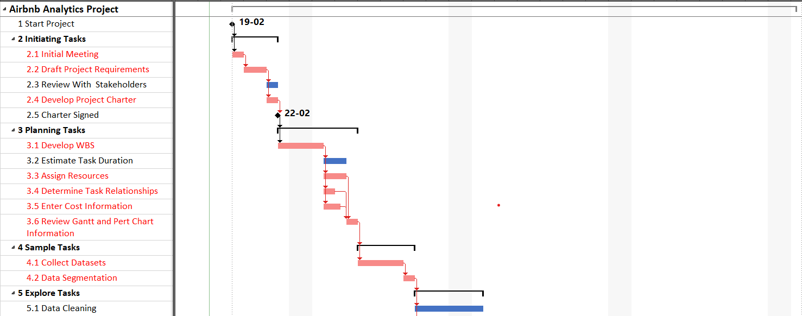
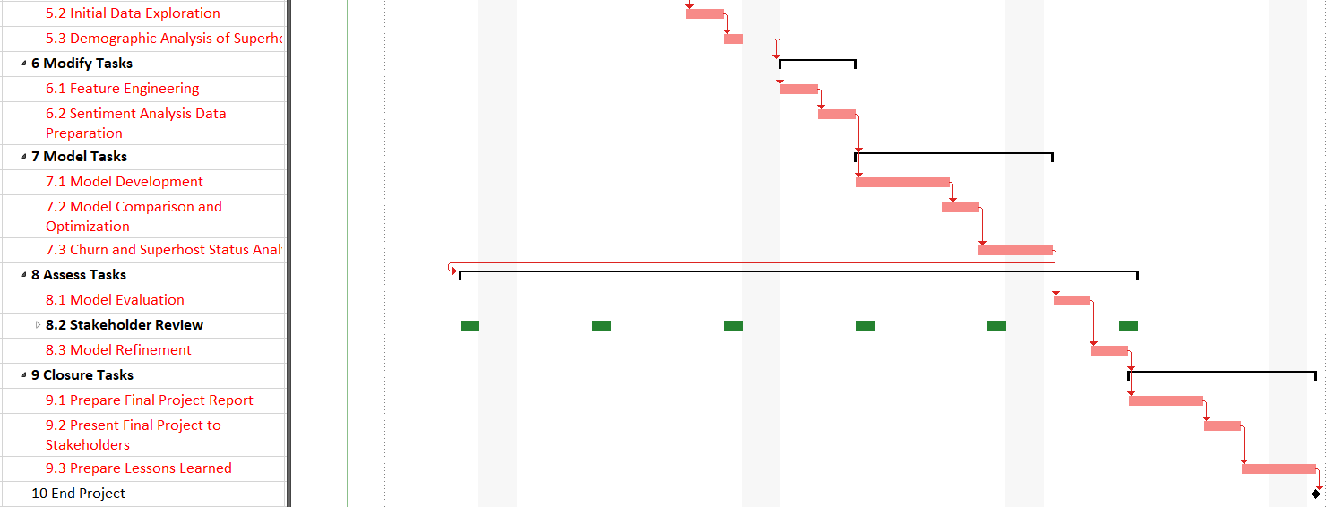
Part II (a): Gantt Chart with Critical Path

Slide 11
Part II(a): Implications of Plan-Based approach
Predictability and Structure: A Plan-based approach offers a high degree of predictability and structure, with detailed planning upfront. This can be particularly beneficial for projects with well-defined requirements and where the scope is unlikely to change significantly.
Comprehensive Documentation: This approach typically involves comprehensive documentation, which can be beneficial for projects that require strict regulatory compliance or where extensive record-keeping is necessary.
Scope Management: Changes to the project scope are generally more challenging to accommodate in a Plan-based approach, potentially leading to delays or increased costs if significant revisions are required.
Risk of Over-Planning: There's a risk of spending too much time in the planning phase, which can delay the start of actual work and might lead to missed opportunities or outdated solutions by the time the project is delivered.
Stakeholder Engagement: Continuous stakeholder engagement can be more challenging, as feedback loops are typically longer, and changes are harder to implement once the project is underway.

Slide 12

Part II (b): Agile Project Management Plan
Methodology: Agile
Environment: Jira
View Board: Kanban
Prioritization Method: MoSCoW
Notes:
Thank you Aravind, Now we will investigate how this plan can be implemented in agile methodology. To do this, There are different environments available online to implement this. We used Atlassian Jira as the environment to implement the plan. We used kanban framework to implement. We have used to MoSCoW method to prioritize tasks, we have segmented each tasks into must have, should have, could have and won’t have tasks. Based on this, we will give highest priority to must have tasks, followed by should have tasks, could have tasks and won’t have tasks.

Slide 13
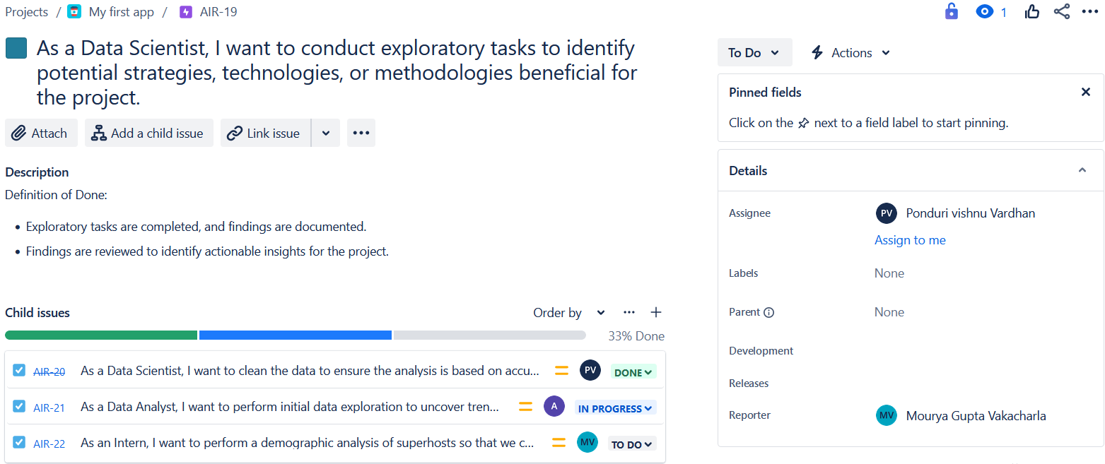
Part II (b): EPIC creation
Notes:
To start, we should create epics, which consists of several user stories or tasks. First, a summary is given similar to as shown here, we can write a description of the epic here . Here definition of done is written. Here the child issues assigned to this epic is shown. We can assign this epic to some one like as shown here.

Slide 14
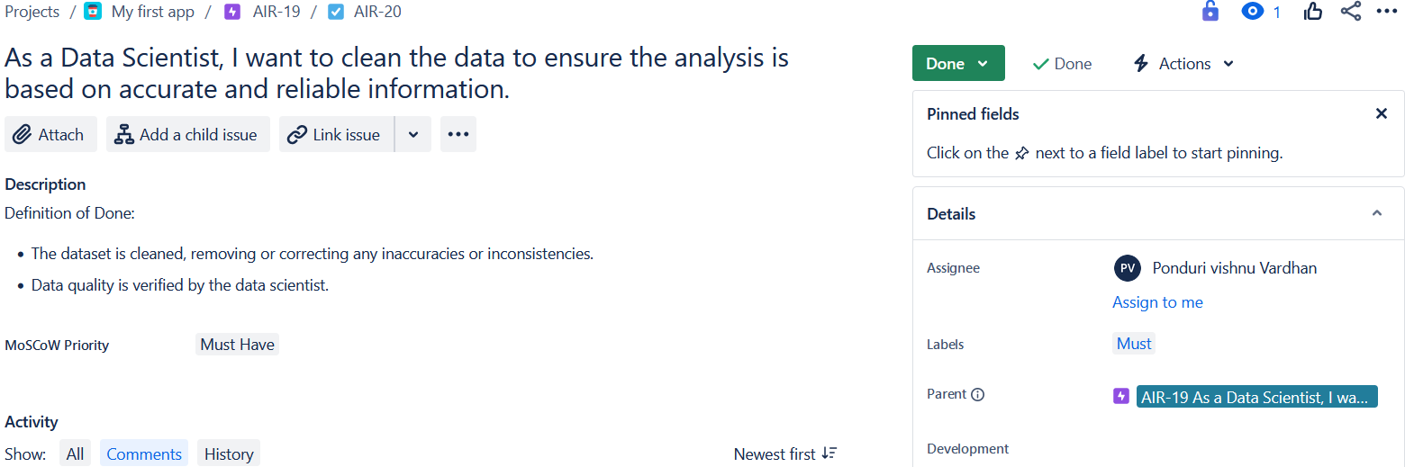
Part II (b): Task creation
Notes:
Next we will move onto creating tasks, it follows similar process to create tasks. To assign the priority based on MOSCOW approach, we have created custom filed called Moscow priority where the priority can be assigned. The labels is also assigned based on Moscow priority to later filter based on the priority. Here parent column is populated with the epic it will go under.

Slide 15
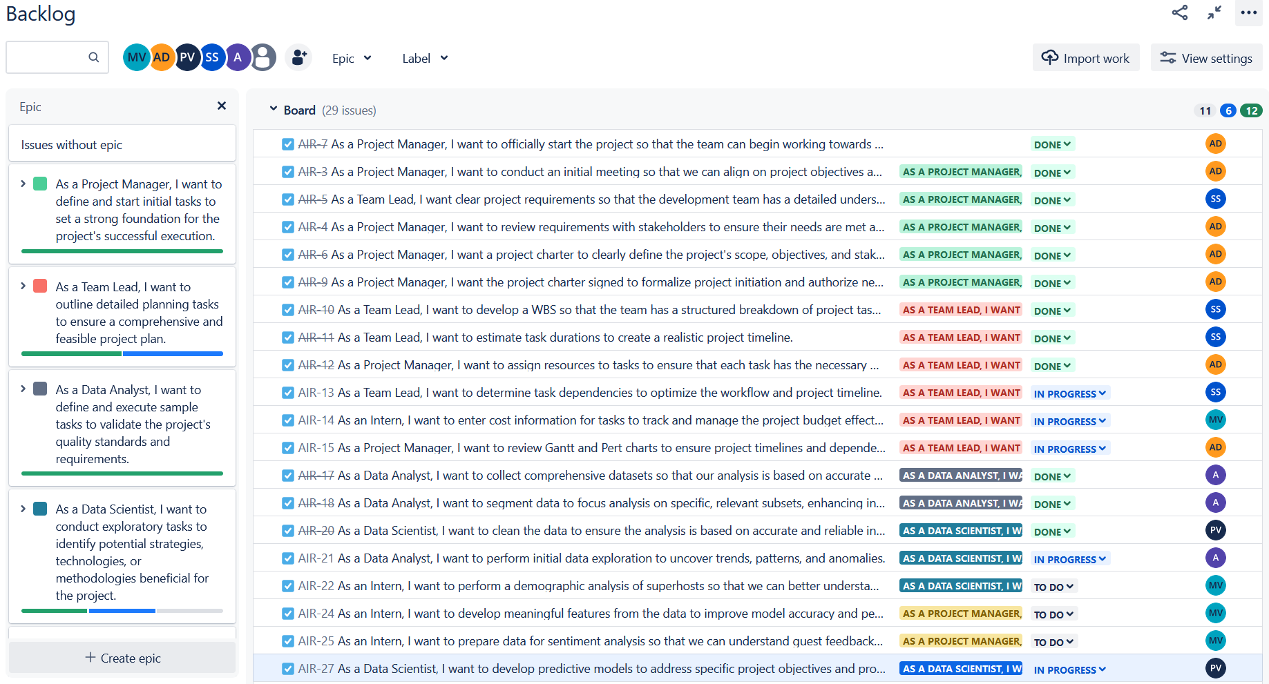
Part II (b): Backlog
Assigned members
Filters
View
EPIC
Colour representation of EPIC
Done
In Progress
To Do
Task
Assigned EPIC
Progress
Assigned member to the task
Notes:
This is the Backlog where all the tasks and epics are displayed.

Slide 16
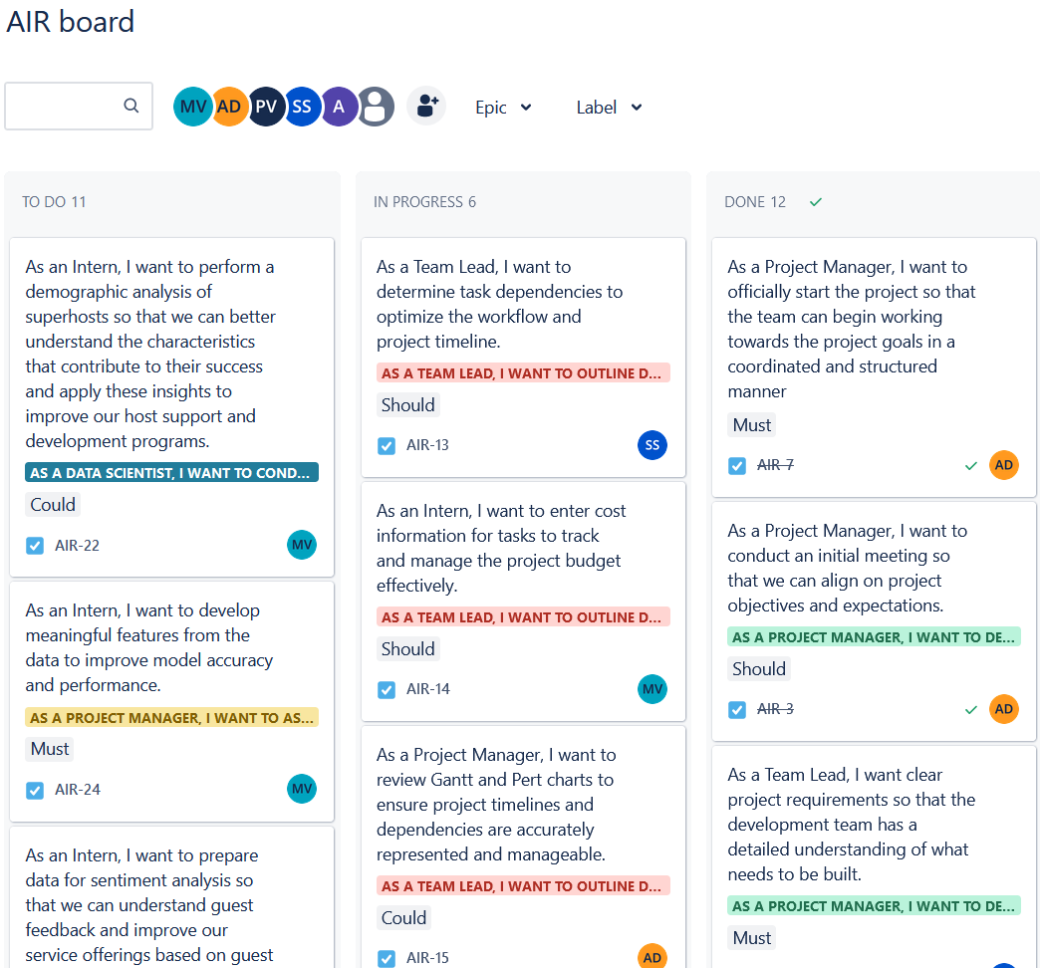
Part II (b): Kanban Board
Notes:
This is the default view of kanban board in Jira. Here all the tasks are divided into three groups. All the tasks that are not started are placed in TO DO column, tasks that are currently going on is placed in In progress column, the tasks that are completed will be placed in Done column.

Slide 17
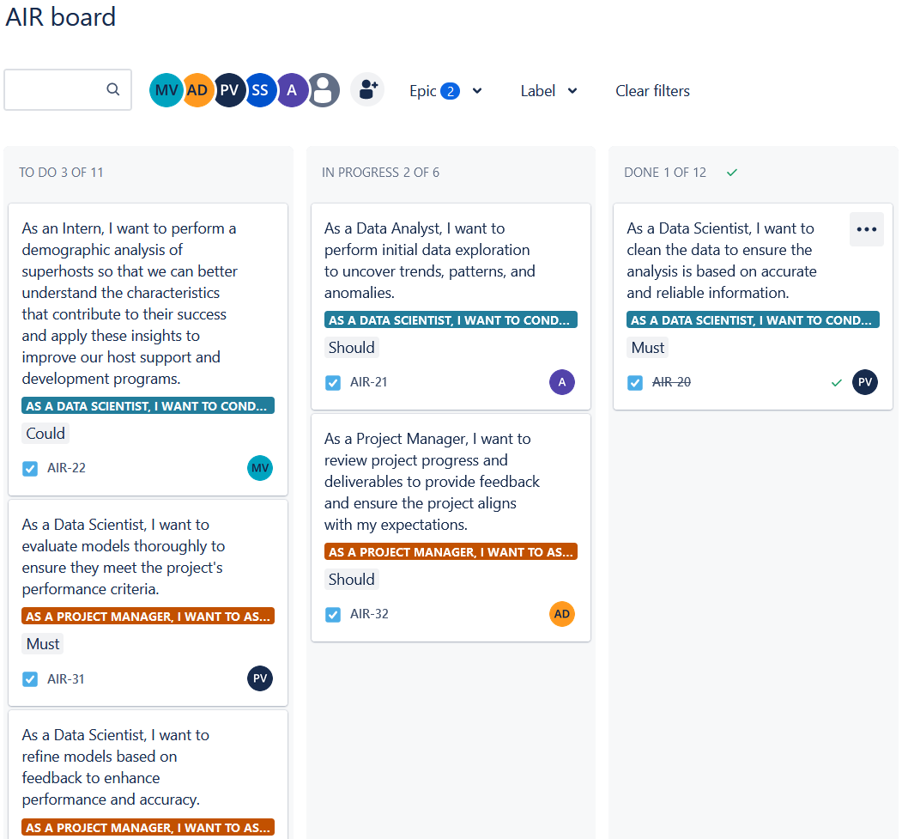
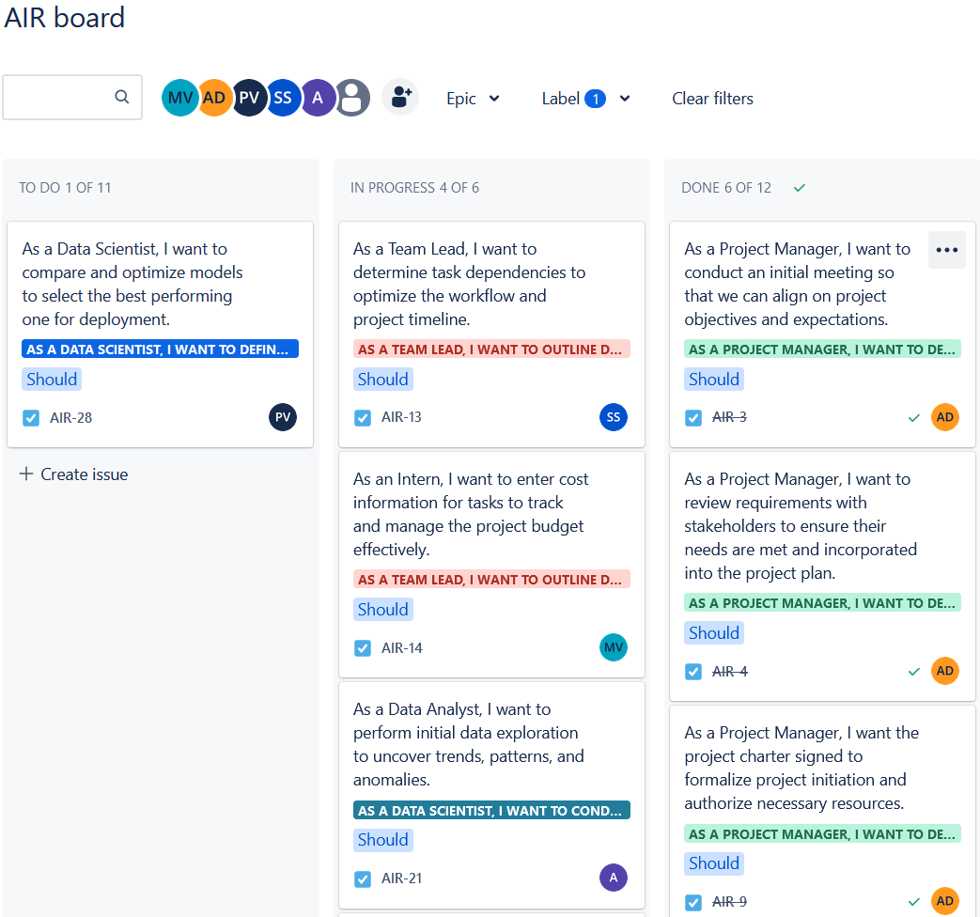
Part II (b): Filters
Filter by Epic
Filter by Label
Notes:
We can apply different filters to view our tasks on kanban board. We can filter by epic, here we have selected two epics, where only tasks related to these epics are shown. Similarly, we can also filter by label, here we have selected only should label, so it is displaying all the tasks with should have priority.

Slide 18
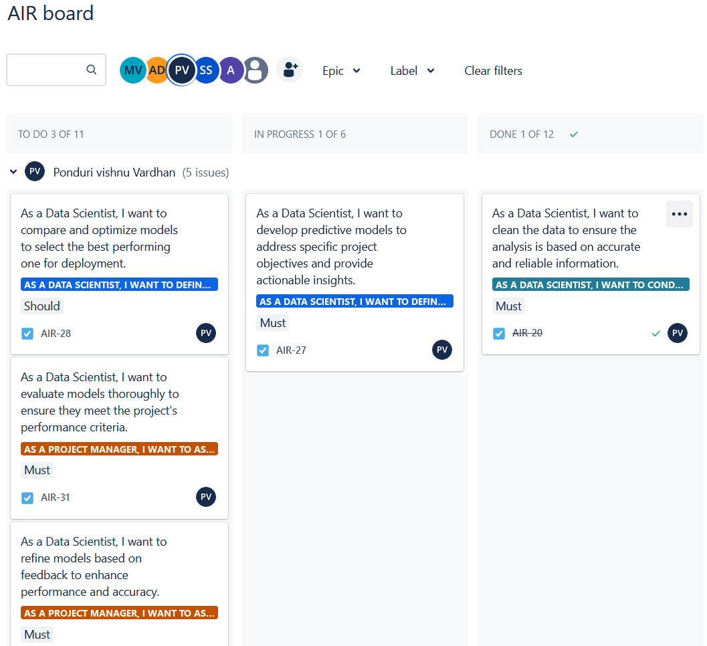
Part II (b): Filter by Assigned Member
Notes:
Here, the tasks are filtered based on assigned member, here we have selected only tasks that are assigned to Vishnu.

Slide 19
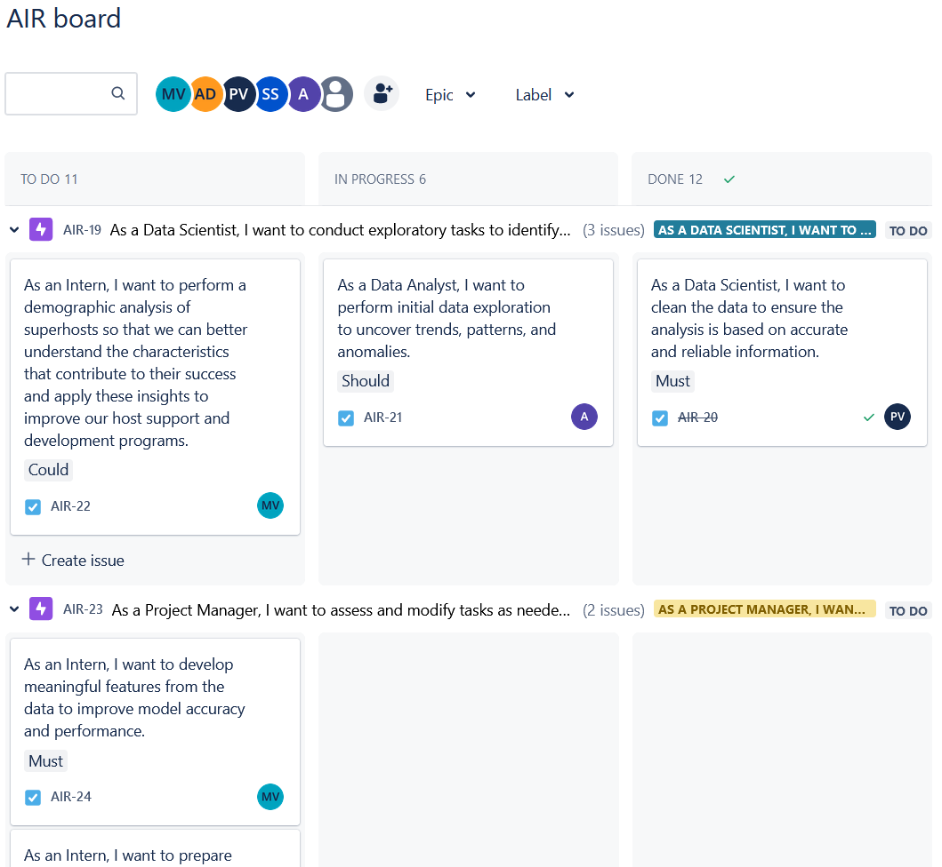
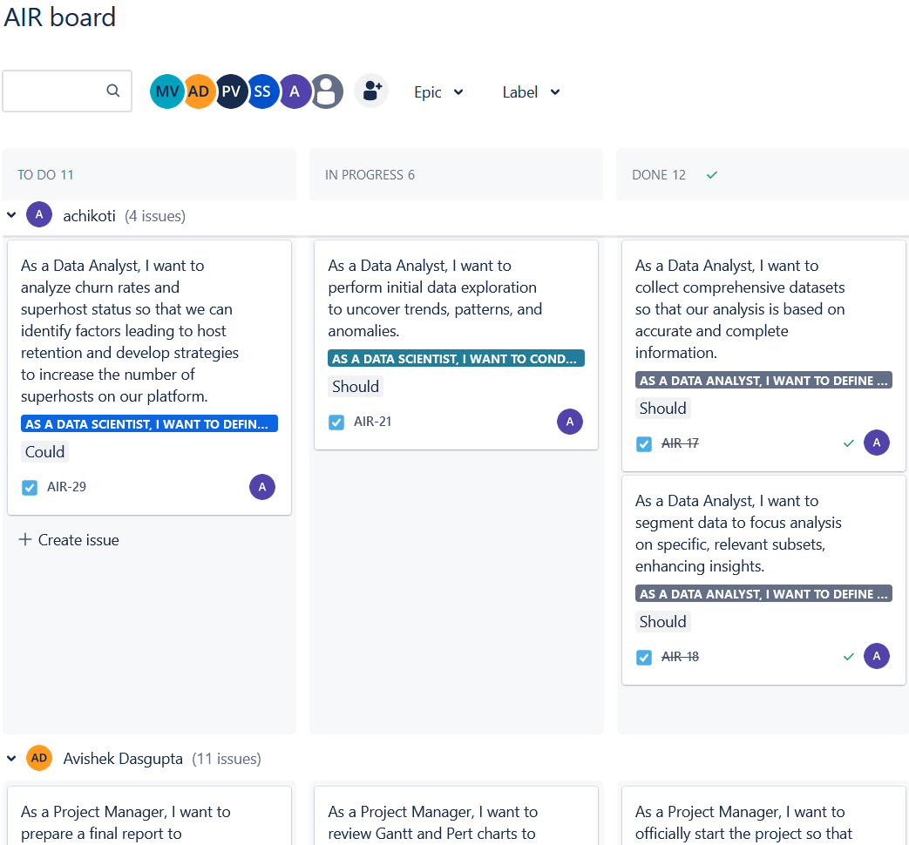
Part II (b): Grouping
Group by EPIC
Group by Assigned member
Notes:
We can also group the tasks on the kanban board based. Here we grouped the tasks based on epics and here the tasks are grouped based on assigned member.

Slide 20
Part II (b): Implications of Agile approach
Flexibility and Responsiveness: Agile methodologies offer greater flexibility, making it easier to adapt to changes in requirements, market conditions, or stakeholder needs, even late in the project.
Incremental Delivery: The focus on iterative and incremental delivery allows for early and frequent releases of working product, which can enhance stakeholder satisfaction and provide early returns on investment.
Enhanced Collaboration: Agile emphasizes close collaboration among team members and with stakeholders, fostering a more dynamic and responsive working environment.
Risk of Scope Creep: Without careful backlog management and prioritization, there's a risk of scope creep as new features and requirements are continually added.
Less Predictability: Agile projects can be less predictable in terms of final deliverable, total cost, and completion date, especially if the project scope is not tightly managed.
Cultural and Organizational Challenges: Adopting Agile practices may require significant cultural and organizational changes, particularly in traditional organizations not accustomed to Agile's collaborative and fast-paced environment.

Slide 21
Part II: Blending both approaches (Hybrid Model)
Leveraging Strengths: Combining elements of both approaches can allow a project to leverage the structure and predictability of Plan-based methods with the flexibility and responsiveness of Agile.
Managing Complex Projects: For complex projects that have both well-defined components and areas requiring exploration and adaptation, a hybrid approach can offer a balanced solution.
Cultural Adaptation: Introducing Agile practices into a traditionally Plan-based environment (or vice versa) can require careful management of cultural and process changes to ensure team buy-in and effective implementation.

Slide 22







Part III: Information on the Data
Sources for obtaining these data:
Public Datasets: Inside Airbnb, Kaggle, Data World, Census data for demographic information and neighborhood characteristics
Web Scraping : Host and property information, including Superhost status, price etc.
High-Level information about the important aspects and features of the datasets required to carry out the analysis
Host performance metrics: Average rating, number of reviews, cancellation rate, and proportion of 5-star reviews etc
Property characteristics: Property type, listing type, number of bedrooms and bathrooms, maximum guests, and cleaning fee etc
Superhosts: Superhost status in current period, superhost change status, count of superhost in tract etc
Geographical factors: ZIP code demographics, census tract statistics, and neighborhood details etc
Prices & Revenue: Nightly Rate, Revenue, Tract Price Variance, Previous Nightly Rate, Previous Revenue etc
Booking & Available Days: Booked days, Available days, number of reservation in last period, tract booking share etc.

Slide 23





Part III: Proposed Analysis
Churn & Superhost Status Analysis
Sentiment Analysis
Machine learning algorithms such as clustering or classification algorithms to identify distinct groups or patterns of tracts with similar booking behavior
Exploratory
Data Analysis
Selecting statistically significant features and creation of interaction terms
Analyzing the sentiment of user reviews to gain deeper insights into guest satisfaction levels, host performance
Logistic regression or machine learning algorithms such as random forests/gradient boosting to forecast the likelihood of hosts attaining or retaining Superhost status
Provide insights into the distribution and trends of summary stats over time
Feature Engineering
Cluster Analysis
Expected Results:
Identification of key performance metrics that strongly influence Superhost status attainment and retention.
Insights into the effectiveness of the Superhost criteria in incentivizing desirable host behaviors and enhancing guest satisfaction.
Identification of potential areas for improvement in the Superhost criteria or certification process
Recommendations for targeted interventions or strategies to increase bookings in underperforming tracts
Identification of key demographic and property-related factors influencing booking behavior

Slide 24
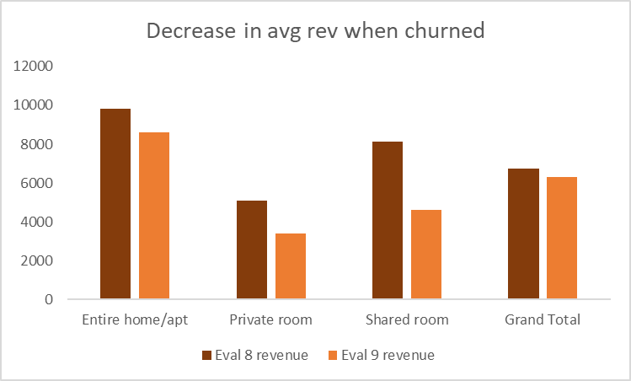
Part IV: Future Work
Objective: Predicting superhost’s churn probability in the next evaluation period
But why predicting is important?
Average Loss of Revenue
Average Loss of Reviews
Average Loss of Occupancy
12%
21%
18%
Losing superhost status adversely affects the host’s business
Not only revenue, but also reviews and occupancy takes a hit
The impact is felt across all types of properties

Slide 25
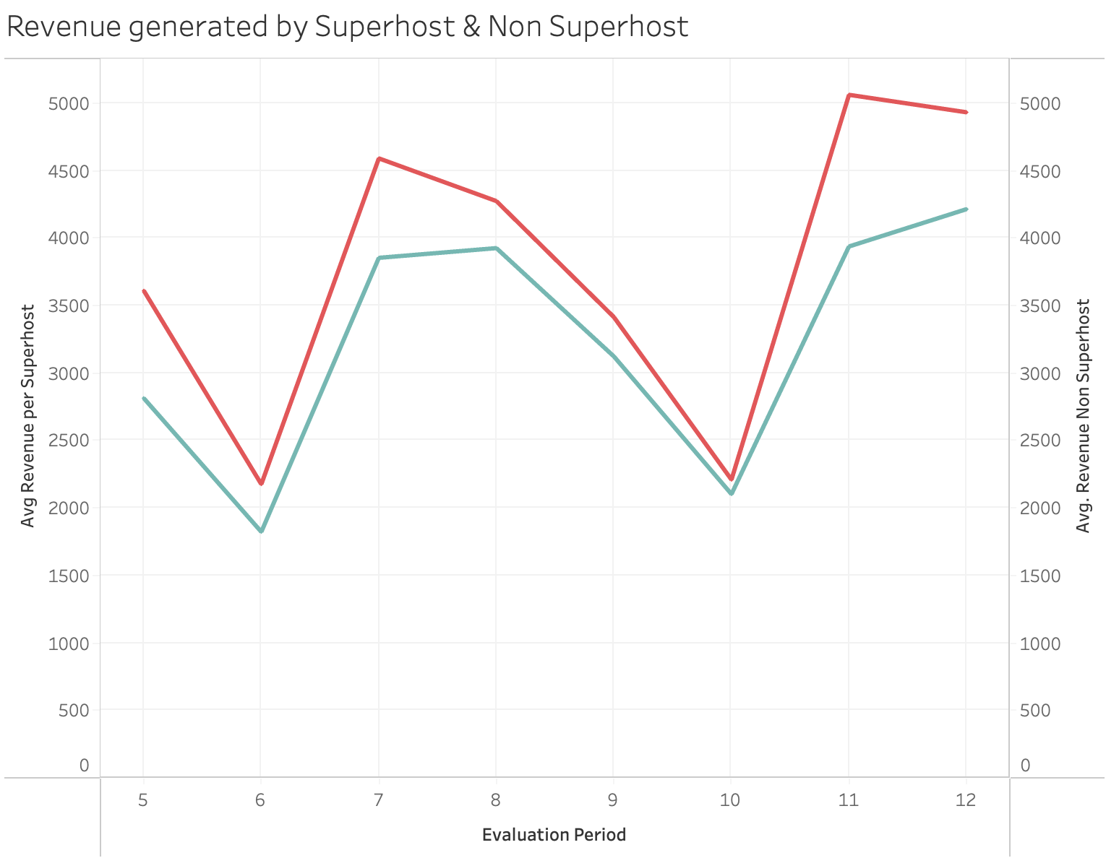

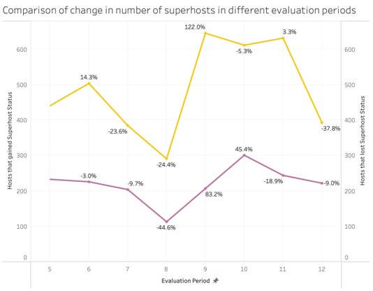

Part IV: Future Work
Avg revenue of Superhost properties is higher than Non Superhost properties
Rate of net change in Superhost has decreased

Slide 26


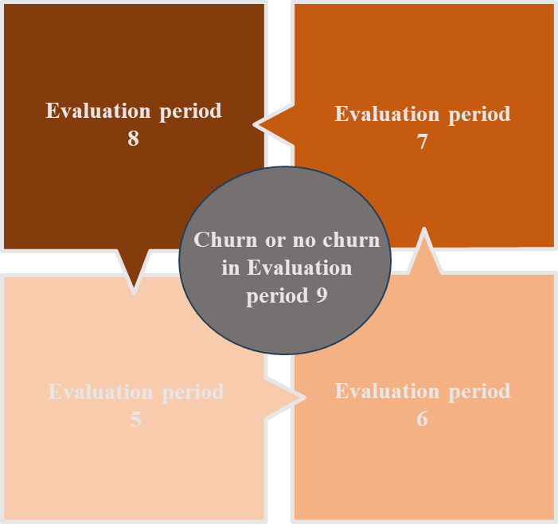
Part IV: Methodology
Potential challenges
30% dataset contains missing values
Imbalanced dataset
Columns requires aggregation
Data preprocessing
Data aggregation
Segregation
Identified numerical and categorical columns
Converted specified columns to string or numerical type
Imputed missing values for interval columns using the group median based on 'Airbnb Property ID’
Imputed missing values for binary columns using the group mode based on 'Airbnb Property ID’
Impute missing values for categorical columns with the mode value within each property type based on 'Airbnb Property ID
Missing Values Imputation
Outlier Imputation
Applied the lower fence imputation function to impute missing values in numerical columns

Slide 27
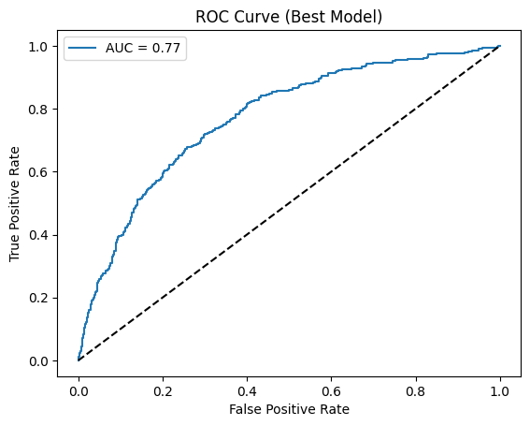
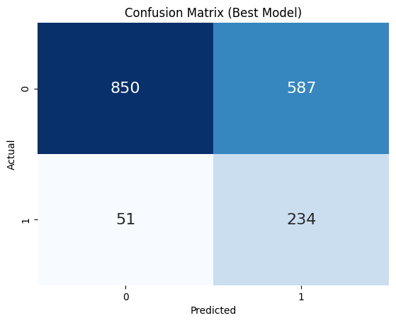
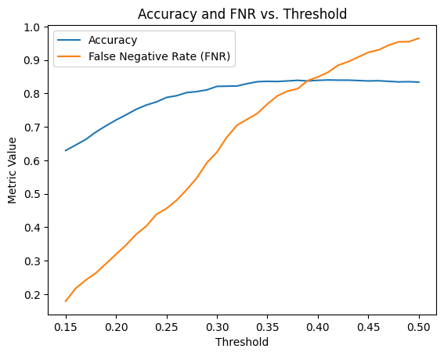
Part IV: Modelling
Model Building Process
Sample Logistic regression model results
Data
Preprocessing
Variable Selection
Threshold Optimization
Data Partition
Hyperparameter Tuning
Cost vs Accuracy
234 out of 285 actual churned hosts were correctly identified
Took a hit on accuracy to decrease the false negative rate
Allows to correctly capture those hosts with a high propensity to churn than random forest
High Sensitivity, easy Interpretability
Imbalance Handling
Model
Exploration

Slide 28

Thank You!
Airbnb

